Slide 1
CHAPTER 4 Optimal Predictive Control 6 Consistent recursive decision making and the tail
Anthony Rossiter

Slide 2
Background on stability of MPC
The earlier chapters considered MPC algorithms such as GPC.
It is clear from the numerous examples that the expected behaviour, and indeed closed-loop stability do not have a simple analytic link to the choice of the horizons.
Indeed, one can easily find examples of GPC where the control law gives closed-loop instability (poor behaviour).
The earlier chapter argued that long horizons helped to ensure a synergy between optimal predictions, desired behaviour and actual closed-loop behaviour; in turn this gives one an expectation, but not guarantee, of good closed-loop behaviour.
This chapter took this to extremes in that the performance index deployed infinite horizons and hence an obvious question is whether that enables better links to closed-loop behaviour and stability?

Slide 3
Sub-optimal dual mode MPC (SOMPC)
Take the dual-mode predictions based around the implementation of an arbitrary regulator and some perturbations.
Optimise predicted performance w.r.t. to the perturbations and implement the first value.
What can we say about the closed-loop stability of this approach?

Slide 4
Foundational concept – the tail
The tail is a language for describing a well-posed sequence of decision making.
At time k, we decide on strategy X and implement the first step.
At time k+1, we update our strategy and decide on strategy Y.
An so on
We call this well posed if, at sample k+1, one can choose to continue implementing the strategy decided at the previous step.

Slide 5
Example of poorly posed problem
FUNDAMENTAL POINT
If you insist that someone must keep changing their mind, then any long term decision making is totally meaningless and chaotic behaviour could result.
Joe is crossing a busy road and plans a route between all the moving cars.
When Joe is halfway across the road, he is informed that he MUST change route!
Assuming his initial planned route was ‘safe’, insisting on a change could be disastrous as there may be no other safe routes.
Even if another safe route exists, it may not be as good as the one he is already on!
If Joe had known in advance that he could not use the whole route planned, no doubt he would have planned a safer alternative position for the halfway point.
PREDICTIVE CONTROL
The same logic applies to MPC decision making. At sample k+1 we must be able to select the remainder of the long term policy decided at sample k.

Slide 6
Foundational concept – the tail
The tail is a language for describing a well-posed sequence of decision making.
The tail is the part of the policy decided at the previous sample that has yet to be implemented, in other words, what is left (analogous to the tail of an animal).
Optimised policy at sample k
The tail, as seen at sample k+1.

Slide 7
Requirement for well-posed MPC
The tail from the previous sample must be included in the class of predictions, otherwise any decision making/optimisation could be meaningless.
If the predicted control trajectory is given as:
Inclusion of the tail implies that it must be possible to choose:

Slide 8
Background
The earlier videos derived the algebra for computing the performance index J assuming the predictions are based on perturbations about a feedback u=-Kx.
In summary the performance index J becomes:
The matrices are defined from:

Slide 9
Interim summary
Before considering stability in detail, we need to ensure that our algorithms have well posed decision making.
In other words, does our algorithm allow the inclusion of the tail in the current predictions?
We will look at the structures of GPC and OMPC and SOMPC.

Slide 10
The tail and GPC
The class of predictions in GPC is based around changes in control, thus consider the predicted future control changes which are all free to choose:
The tail from the previous sample is given as:
It is obvious that the tail is included in the class of predictions at the current sample.

Slide 11
The tail and OMPC/SOMPC
The class of predictions in OMPC are based around perturbations to an underlying feedback u=-Kx:
The tail from the previous sample is given as:
It is obvious that the tail is included in the class of predictions at the current sample.

Slide 12
Summary for well-posed optimisations
A first requirement for expecting good apriori stability results is that the recursive decision making can be consistent from one sample to the next, otherwise chaos may ensue.
This requirement can be captured mathematically using the concept of the tail, that is the part of the previous optimal strategy yet to be implemented.
A well posed MPC algorithm should include the tail in the class of predictions over which the optimisation is performed at each sample.
It is shown that GPC, OMPC and SOMPC all include the tail automatically.

Slide 13



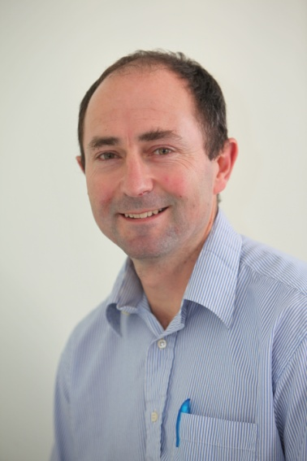
Anthony Rossiter
Department of Automatic Control and Systems Engineering
University of Sheffield
www.shef.ac.uk/acse
© 2014 University of Sheffield
This work is licensed under the Creative Commons Attribution 2.0 UK: England & Wales Licence. To view a copy of this licence, visit http://creativecommons.org/licenses/by/2.0/uk/ or send a letter to: Creative Commons, 171 Second Street, Suite 300, San Francisco, California 94105, USA.
It should be noted that some of the materials contained within this resource are subject to third party rights and any copyright notices must remain with these materials in the event of reuse or repurposing.
If there are third party images within the resource please do not remove or alter any of the copyright notices or website details shown below the image.
(Please list details of the third party rights contained within this work.
If you include your institutions logo on the cover please include reference to the fact that it is a trade mark and all copyright in that image is reserved.)

